Slide 1
Fundamental principles of interaction

Slide 2
Life is made of experiences
Great designers produce pleasurable experiences. Engineers tend not to like it; it is too subjective. But…
“when I ask them about their favorite automobile or test equipment, they will smile delightedly as they discuss the fit and finish, the sensation of power during acceleration, their ease of control while shifting or steering, or the wonderful feel of the knobs and switches on the instrument.” Those are experiences! (D. Norman)
Experience is critical, for it determines how fondly people remember their interactions. Was the overall experience positive, or was it frustrating and confusing?

Slide 3
Donald Norman video course playlist https://www.youtube.com/playlist?list=PLAwxTw4SYaPlr4Uq3RoYuwlDADp0WQdGl

Slide 4
Cognition and emotion
When our home technology behaves in an uninterpretable fashion we can become confused, frustrated, and even angry—all strong negative emotions.
When there is understanding it can lead to a feeling of control, of mastery, and of satisfaction or even pride — all strong positive emotions.
Cognition and emotion are tightly intertwined, which means that the designers must design with both in mind.
https://www.youtube.com/watch?v=LTE-v4RzRHs&list=PLJOFJ3Ok_idv_6hQGNt23xVXuQwKFmfxG&index=8&ab_channel=NNgroup

Slide 5
Discoverability
When we interact with a product, we need to figure out how to work it. This means discovering what it does, how it works, and what operations are possible.
Discoverability results from appropriate application of 6 fundamental psychological principles:
affordances
signifiers
constraints
mappings
feedback
conceptual model of the system

Slide 6
AFFORDANCES

Slide 7
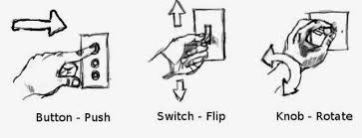
Affordances
The term affordance refers to the relationship between a physical object and a person.
An affordance is a relationship between the properties of an object and the capabilities of the agent that determine just how the object could possibly be used.
A chair affords (“is for”) support and, therefore, affords sitting.

Slide 8
Affordances are relationships
We are used to thinking that properties are associated with objects.
But affordance is not a property.
An affordance is a relationship.
Whether an affordance exists depends upon the properties of both the object and the agent.

Slide 9
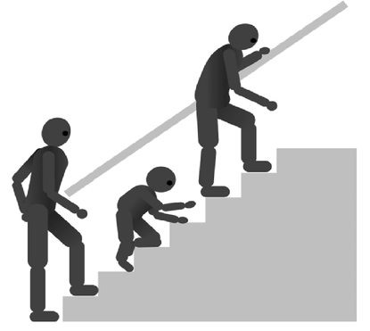
Affordances are relationships
Most chairs can also be carried by a single person (they afford lifting), but some can only be lifted by a strong person. If young or relatively weak people cannot lift a chair, then for these people, the chair does not have that affordance, it does not afford lifting.
https://www.youtube.com/watch?v=NK1Zb_5VxuM&ab_channel=Interaction-Design.org

Slide 10

Anti-affordance
anti-affordance -> the prevention of interaction.

Slide 11
Affordances
To be effective, affordances and anti-affordances have to be: discoverable and perceivable.
This poses a difficulty with glass. The reason we like glass is its relative invisibility, but this aspect, so useful in the normal window, also hides its anti-affordance property of blocking passage.
As a result, birds often try to fly through windows.

Slide 12
SIGNIFIERS

Slide 13
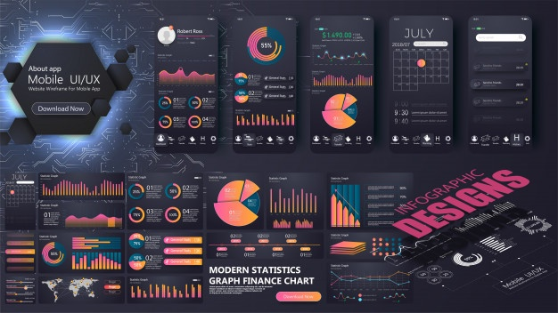
Signifiers
Designers have practical problems.
They need to know how to design things to make them understandable.
They soon discovered that when working with the graphical designs for electronic displays, they needed a way to designate which parts could be touched, slided upward, downward, or sideways, or tapped upon.

Slide 14
Signifiers
How could designers describe what they were doing?
There was no word that fit, so they took the closest existing word: affordance.
“I put an affordance there” to describe why they displayed a circle on a screen to indicate where the person should touch, whether by mouse or by finger.
NO -> that is not an affordance! That is a way of communicating where the touch should be.
You are communicating where to do the touching!

Slide 15
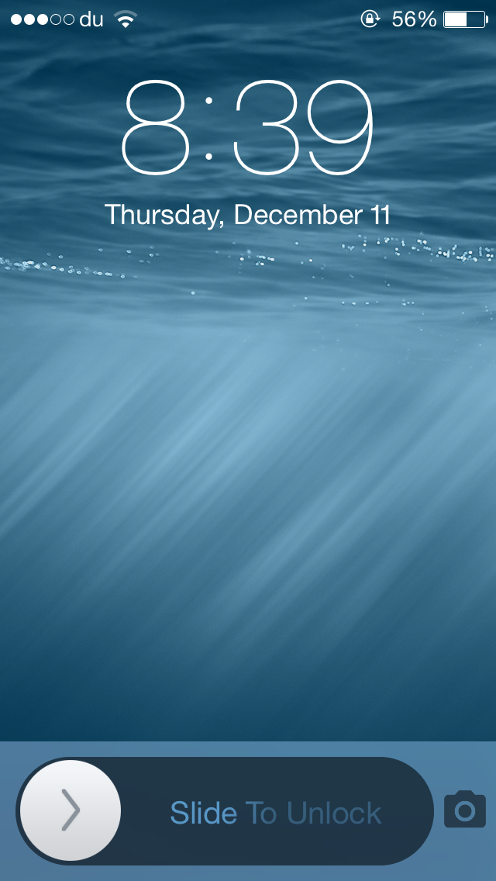
Signifiers
The affordance of touching exists on the entire screen:
That’s not the same thing as saying what action is possible.
Affordances determine what actions are possible.
Signifiers communicate where the action should take place.

Slide 16
Signifiers
Affordance
The affordance of touching exists on the entire screen:
That’s not the same thing as saying what action is possible.
Affordances determine what actions are possible.
Signifiers communicate where the action should take place.
Signifier
S

Slide 17
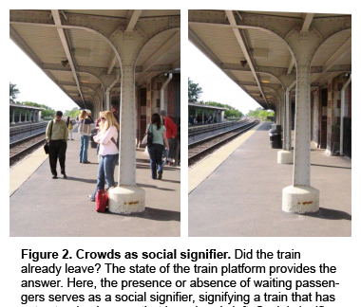
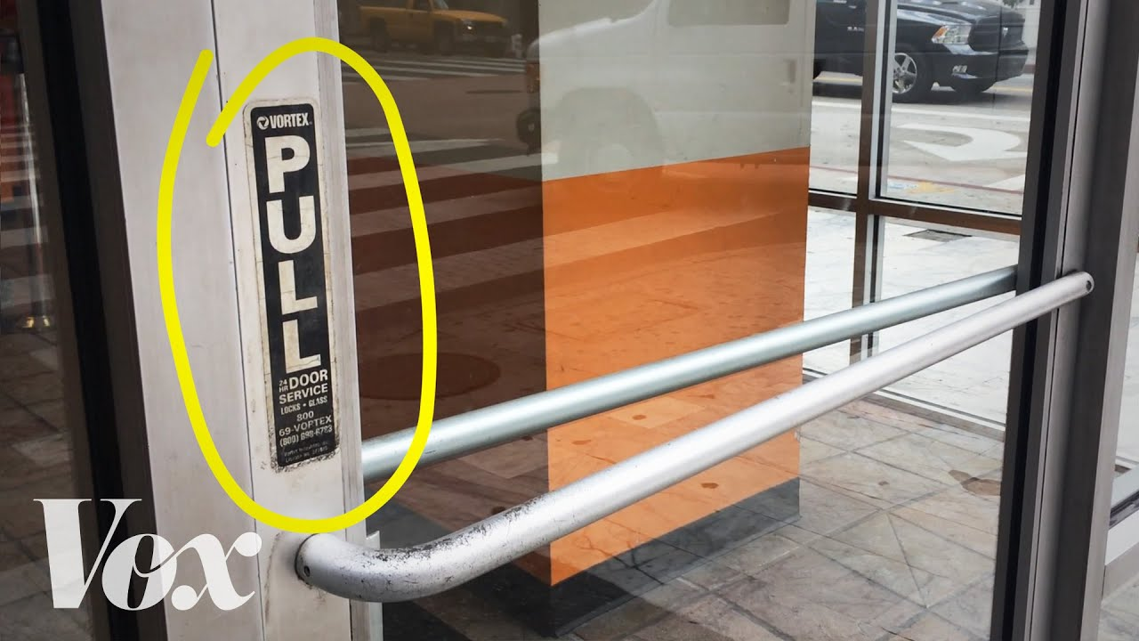
Signifiers
Signifiers can be deliberate and intentional, such as the sign push on a door
they may also be accidental and unintentional, such as our use of the visible trail made by previous people walking through a field or over a snow-covered terrain to determine the best path.

Slide 18
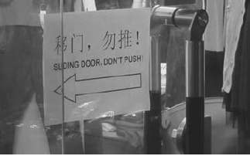
Signifiers
Affordances represent the possibilities in the world for how an agent can interact with something. Some affordances are perceivable, others are invisible.
Signifiers are signals. Some signifiers are signs, labels, and drawings placed in the world
Some signifiers are simply the perceived affordances, such as the handle of a door
Note that some perceived affordances may not be real

Slide 19

Signifiers
In design, signifiers are more important than affordances, for they communicate how to use the design

Slide 20
Perceiving affordances and signifiers
But how does one go from the perception of an affordance to understanding the potential action?
In many cases, through conventions.
A doorknob has the perceived affordance of graspability. But knowing that it is the doorknob that is used to open and close doors is learned: it is a cultural aspect of the design that knobs, handles, and bars, when placed on doors, are intended to enable the opening and shutting of those doors. The same devices on fixed walls would have a different interpretation: they might offer support, for example, but certainly not the possibility of opening the wall.
The interpretation of a perceived affordance is a cultural convention.

Slide 21
https://www.youtube.com/watch?v=UtulTXJLGOI&ab_channel=LeahGreis

Slide 22
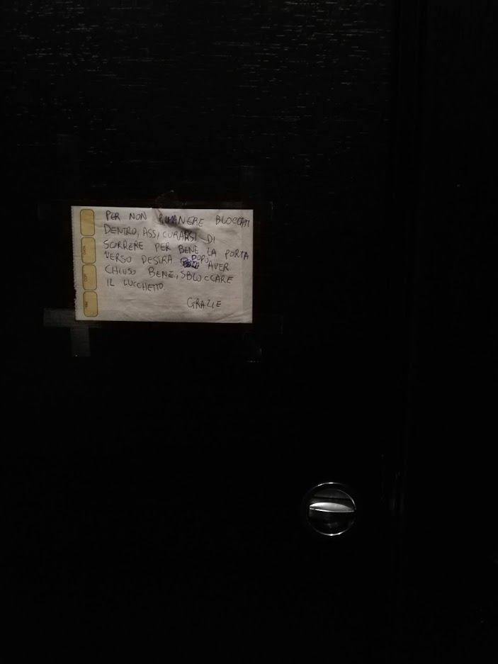

Slide 23
MAPPING

Slide 24
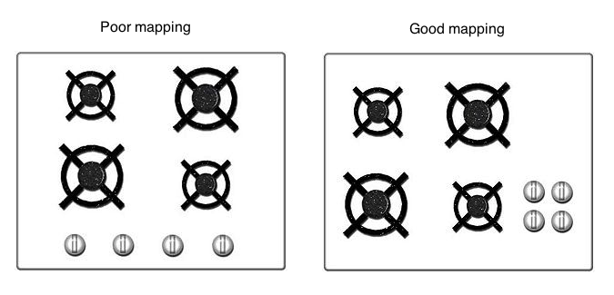
Mapping
Mapping means the relationship between the elements of two sets of things.
Mapping is an important concept in the design and layout of controls and displays. When the mapping uses spatial correspondence between the layout of the controls and the devices being controlled, it is easy to determine how to use them.
Natural mapping (taking advantage of spatial analogies) leads to immediate understanding.

Slide 25
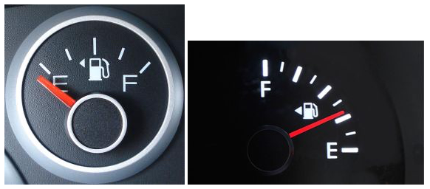
Mapping
Some natural mappings are cultural or biological, as in the universal standard that moving the hand up signifies more, moving it down signifies less, which is why it is appropriate to use vertical position to represent intensity or amount.
Note that there are many mappings that feel “natural” but in fact are specific to a particular culture.

Slide 26
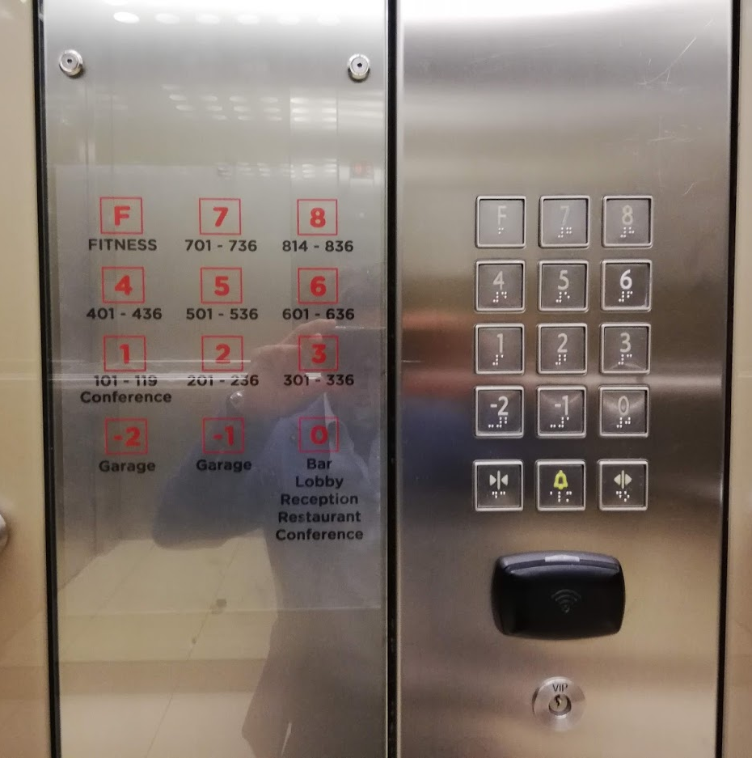

Slide 27
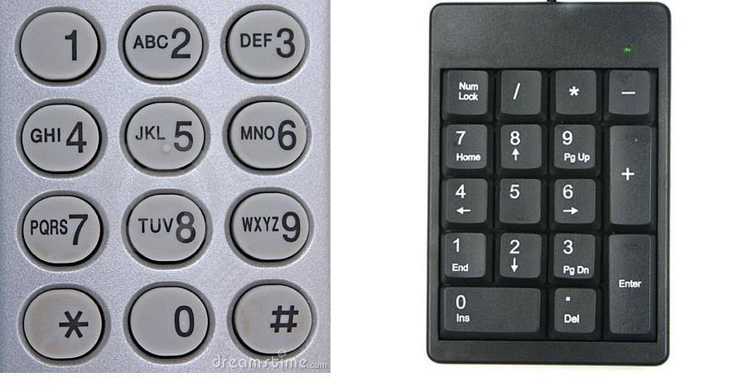

Slide 28
FEEDBACK

Slide 29
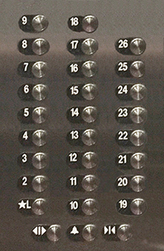

Feedback
Ever watch people at an elevator repeatedly push the Up button, or repeatedly push the pedestrian button at a street crossing?
What is missing in these cases is feedback: some way of letting you know that the system is working on your request.
Feedback: communicating the results of an action

Slide 30
Feedback
Feedback must be immediate
even a delay of a tenth of a second can be disconcerting. If the delay is too long, people often give up, going off to do other activities.
Feedback must also be informative.
Poor feedback can be worse than no feedback at all, because it is distracting, uninformative, and in many cases irritating and anxiety-provoking.
“My dishwasher likes to beep at three a.m. to tell me that the wash is done, defeating my goal of having it work in the middle of the night so as not to disturb anyone”

Slide 31
Feedback
Too many announcements cause people to ignore all of them, or wherever possible, disable all of them, which means that critical and important ones are apt to be missed.
Feedback is essential, but not when it gets in the way of other things, including a calm and relaxing environment.
Notifications become useless!

Slide 32
CONCEPTUAL MODEL

Slide 33
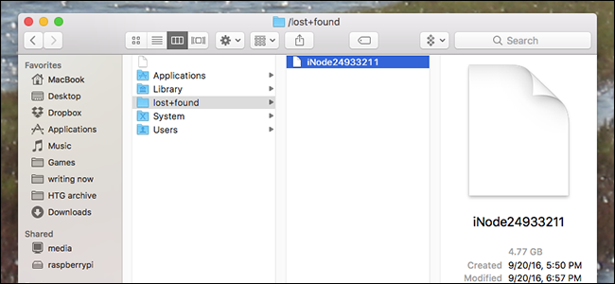
Conceptual Model
A conceptual model is an explanation, usually highly simplified, of how something works. It doesn’t have to be complete or even accurate as long as it is useful.
The files, folders, and icons you see displayed on a computer screen help people create the conceptual model of documents and folders inside the computer, or of apps or applications residing on the screen, waiting to be summoned.
In fact, there are no folders inside the computer, those are effective conceptualizations designed to make them easier to use.

Slide 34
Conceptual Model
Simplified models are valuable only as long as the assumptions that support them hold true.
Cloud Storage Sync: files appear to be on the device. But in fact, in many cases the actual material is “in the cloud”.
The conceptual model is of one coherent storage available on all the user’s devices.
This simplified model is helpful for normal usage, but if the network connection to the cloud services is interrupted, the result can be confusing.
Files are still shown on users device screen, but users can no longer open save it

Slide 35
Mental Model
Mental models, are the conceptual models in people’s minds that represent their understanding of how things work.
Different people may hold different mental models of the same item.
Indeed, a single person might have multiple models of the same item, each dealing with a different aspect of its operation: the models can even be in conflict.

Slide 36
Conceptual Model
Conceptual models are often inferred from the device itself.
Some models are passed on from person to person. Some come from manuals.
Usually the device itself offers very little assistance, so the model is constructed by experience. Quite often these models are erroneous, and therefore lead to difficulties in using the device.

Slide 37
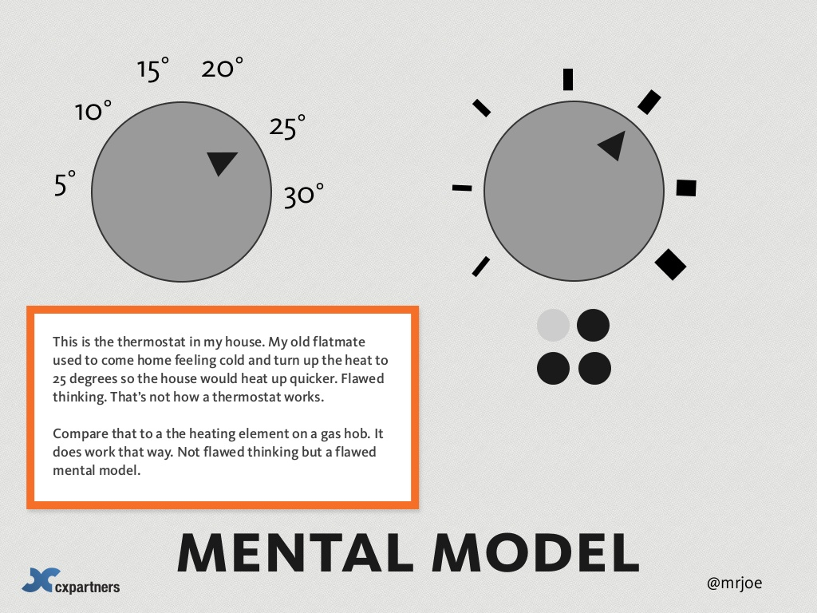
https://www.slideshare.net/cxpartners/psychology-for-designers-or-3-predictions-from-psychology-for-the-future-of-web-design-by-mrjoe/27-mrjoe51015_2025mental_model30This_is_the

Slide 38

Conceptual Model

Slide 39
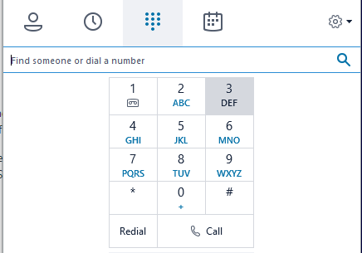
Conceptual Model

Slide 40
SYSTEM IMAGE

Slide 41
System Image
People create mental models of themselves, others, the environment, and the things with which they interact.
These are conceptual models formed through experience, training, and instruction.
These models serve as guides to help achieve our goals and in understanding the world.

Slide 42
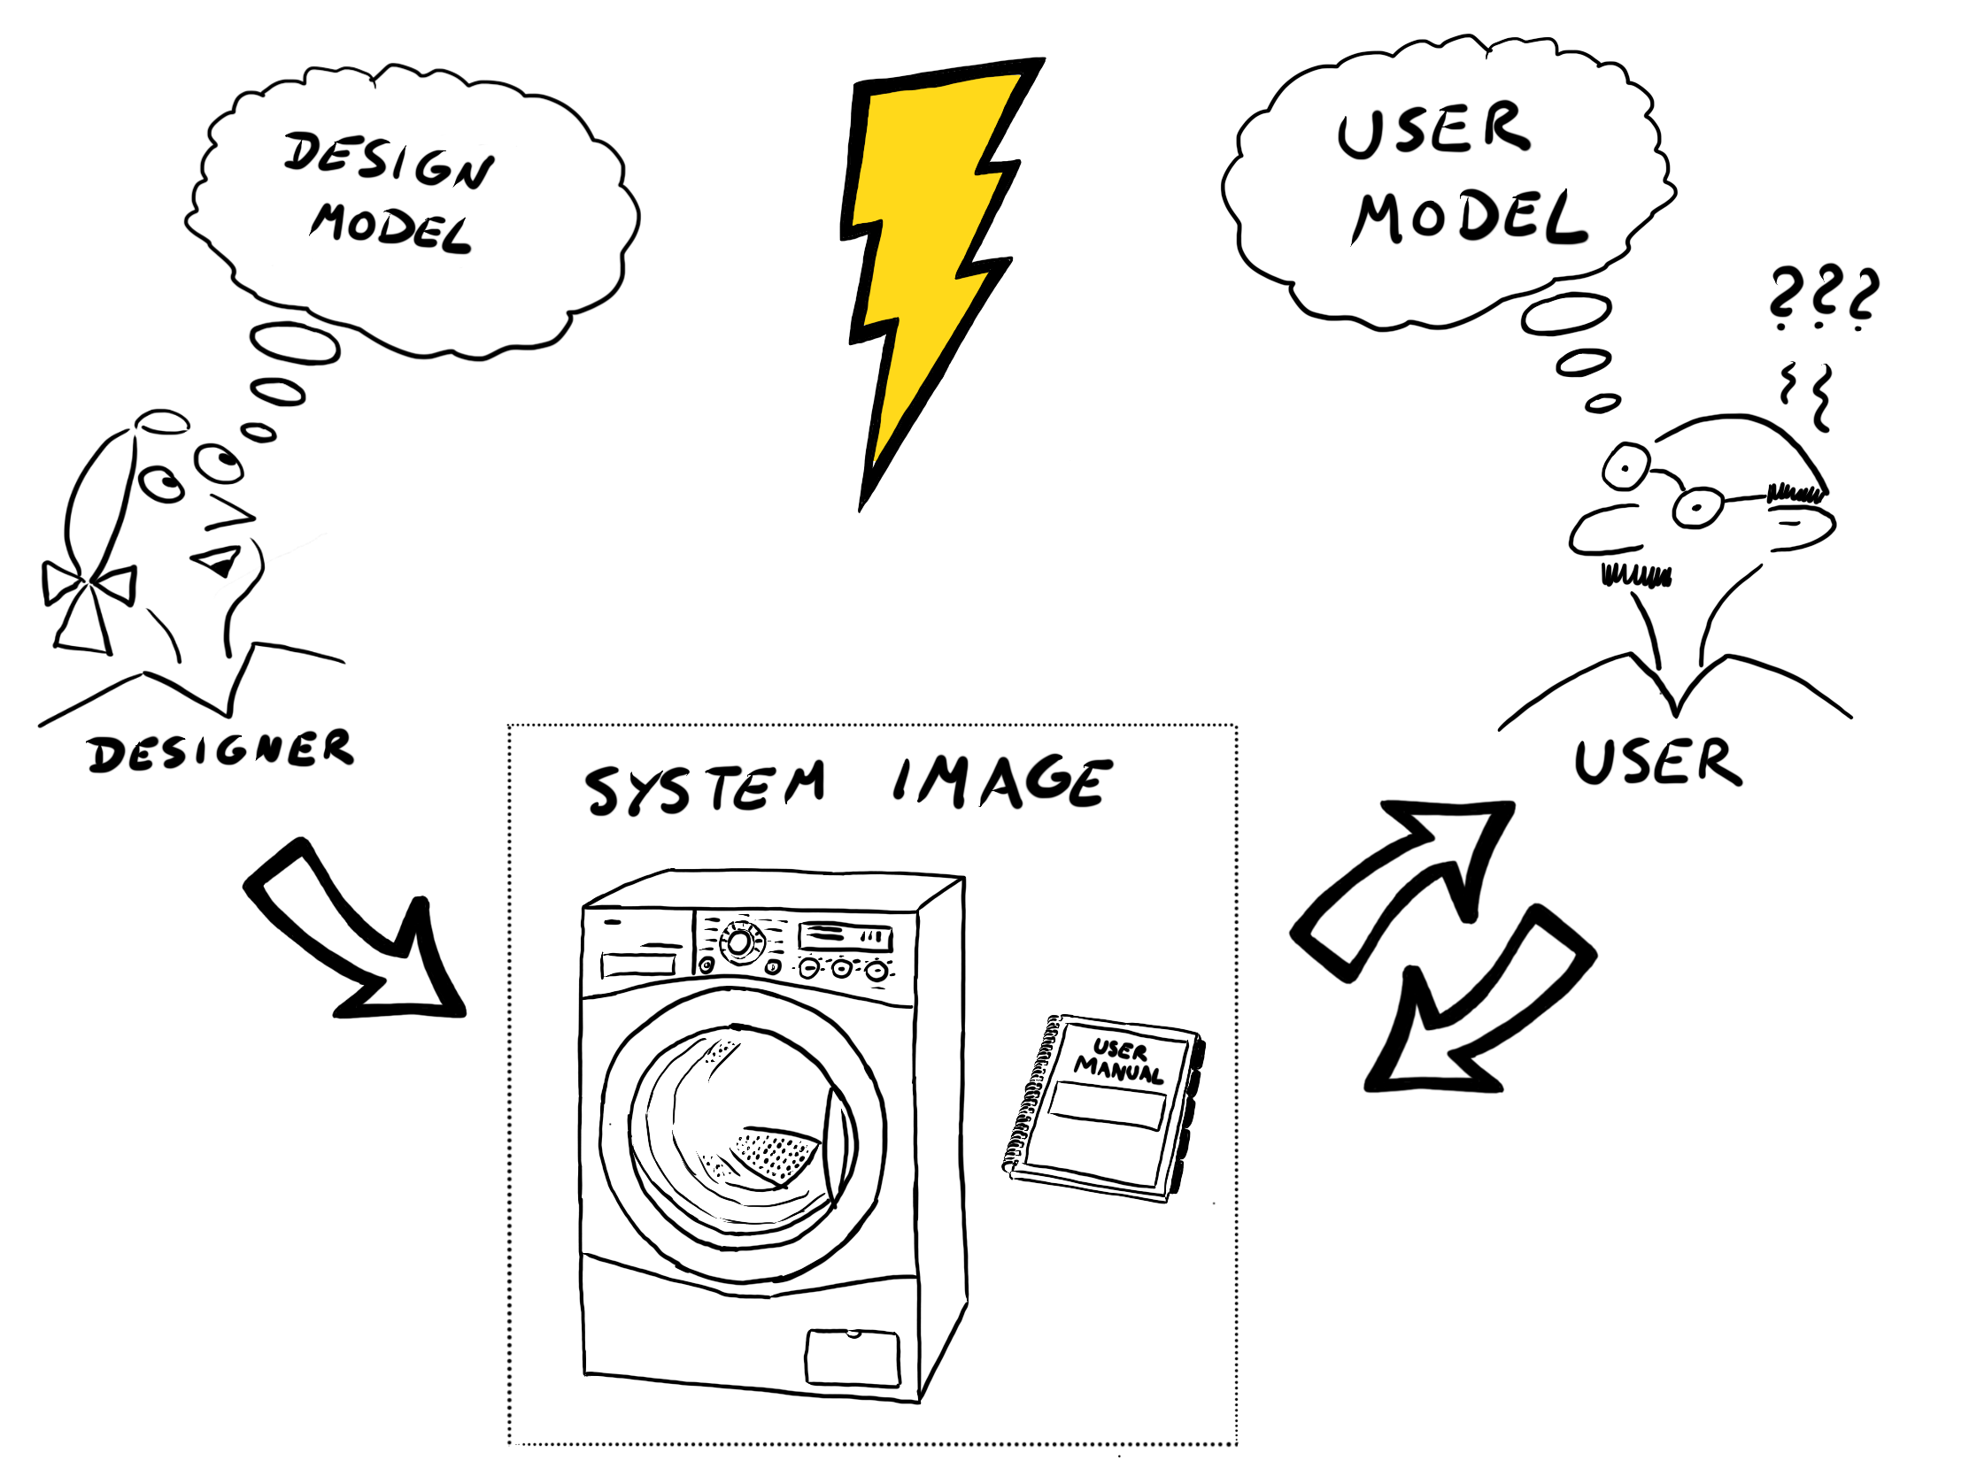
System Image
How do we form an appropriate conceptual model for the devices we interact with?
We cannot talk to the designer, so we rely upon whatever information is available to us: what the device looks like, what we know from using similar things in the past, what was told to us in the sales literature, by salespeople and advertisements, by articles we may have read, by the product website and instruction manuals.
Combined information available to us is the system image.

Slide 43
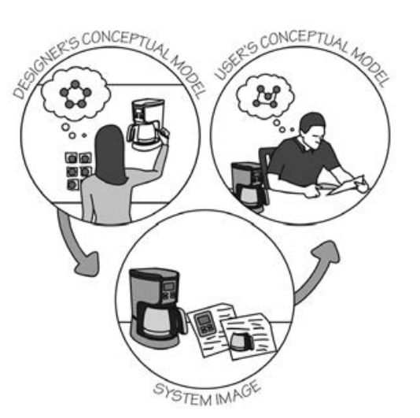
System Image
When the system image is incoherent or inappropriate, then the user cannot easily use the device. If it is incomplete or contradictory, there will be trouble.
The designer’s conceptual model is the designer’s conception of the product, occupying one vertex of the triangle. After sale the product itself is no longer with the designer, so it is isolated as a second vertex, perhaps on the user’s kitchen or wall.
The system image is what can be perceived from the physical structure that has been built

Slide 44
https://www.youtube.com/watch?v=shSCUNxtn18&ab_channel=LeahGreis

Slide 45
Example: System image of a smart Thermostat
Vimar Wifi https://www.vimar.com/it/it/cronotermostato-touch-screen-wi-fi-da-parete-02911-video-guida-a-11721152.html
NEST https://www.youtube.com/watch?v=dHKD-9uI24I
:) https://www.youtube.com/watch?v=5yJOyKr4GBA

Slide 46
Changing Conventions
People invariably object and complain whenever a new approach is introduced into an existing array of products and systems.
Conventions are violated -> new learning is required.
The merits of the new system are irrelevant: it is the change that is upsetting.
Consistency in design is virtuous.
If a new way of doing things is only slightly better than the old, it is better to be consistent. But if there is to be a change, everybody has to change.
NB: Mixed systems are confusing to everyone!

Slide 47
Rethinking OS
https://uxdesign.cc/introducing-mercury-os-f4de45a04289

